Slide 1
Civil Administration System
GROUP-3
1.Tapan kumar Mahapatra(1705106028)
2.Birendra kumar Behera(170510620)
3.Prangyasini Behera(1705106001)

Slide 2
Content
Introduction
Project Scope
Existing System
Proposed Solution
System Requirement
System Design
Architecture
Modules
Conclusion

Slide 3
INTRODUCTION
The project is built to connect the local public with the higher officials in the Civil Administration Office.
This system is built to connect the local public with the higher officials in the Civil Administration Office.
The government faces daily challenges in an attempt to provide cooperation to all citizens who depend on the public services.
The user must register to an account and state a complaint to the authority with the generated unique ID.
Complaints can be easily registered by the user and can be tracked with a unique complaint ID.

Slide 4
Project Scope
The system connects local people with higher authority.
User can post the problem he is facing and can upload the images and videos of the problem.
User can suggest new ideas to solve the problem.
The system can save the times of complaint filters.
The system also helps the user to track the complaint and its status.
This system helps the authority to avoid paperwork.
This system helps the authority to avoid the lengthy work.

Slide 5
Existing system
No registration facility is provided and can post the problems directly.
Can’t get the information regarding funds allotted to the problem and other basic information.
A citizen can’t give a suggestion for solving the problem in a better way.
Fake problems can be entered and there is no possibility to verify before solving the problem.

Slide 6
Proposed system
Registration is provided so that officer can solve the problems easily.
Complete information regarding the place is displayed.
Can suggest a solution for solving the problems in a better way.
Can comment on the government’s decisions.

Slide 7
System Requirement
System requirements consists of 2 things:
Software Requirements
Hardware Requirements

Slide 8
Software Requirements
Frontend
1. Android Development Tools
2. Java
3. XML
4.Html
5.css
Backend
1.MySQL
2.php
IDE
1.Android Studio

Slide 9
Hardware Requirements
Application Requirement
1. Android version 6.0 (Marshmallow onwards)
2. 4GB RAM
3 . 1.2 GHZ Processor
Development Environment Requirement
1. Intel i3 5th Generation Processor
2.Windows 10 / UBUNTU 14.0.4
3.Android Studio Installed

Slide 10
System Design
The purpose of the System Design process is to provide sufficient detailed data and information about the system.
1.Class Diagram
2.Usecase Diagram

Slide 11
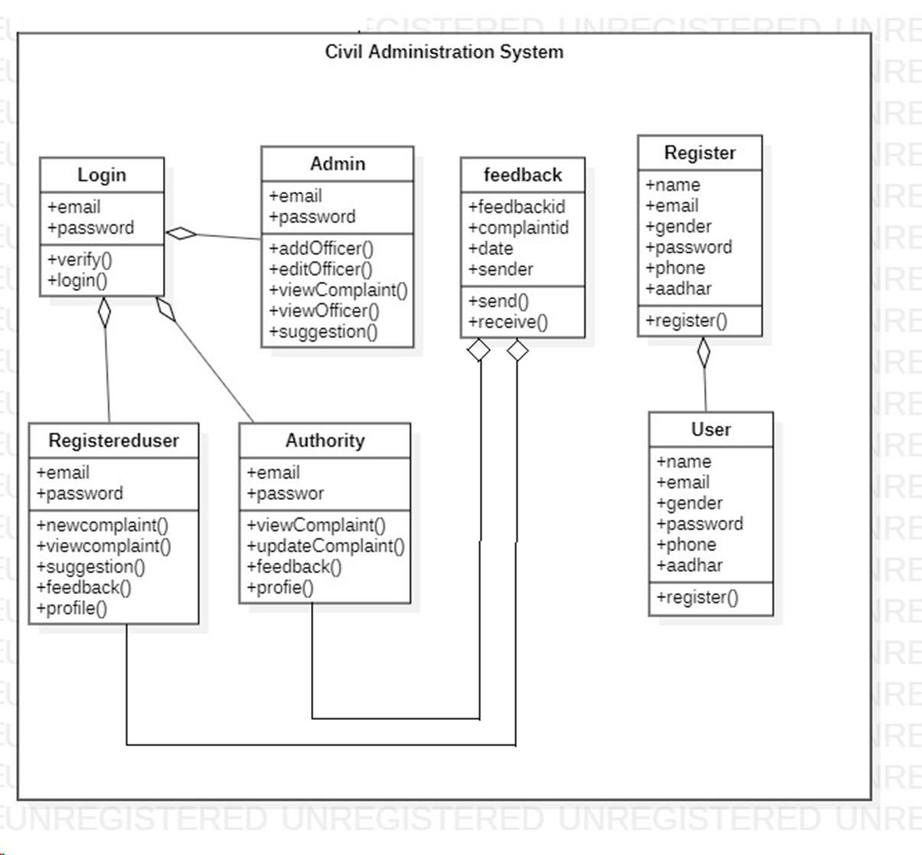
Class Diagram

Slide 12
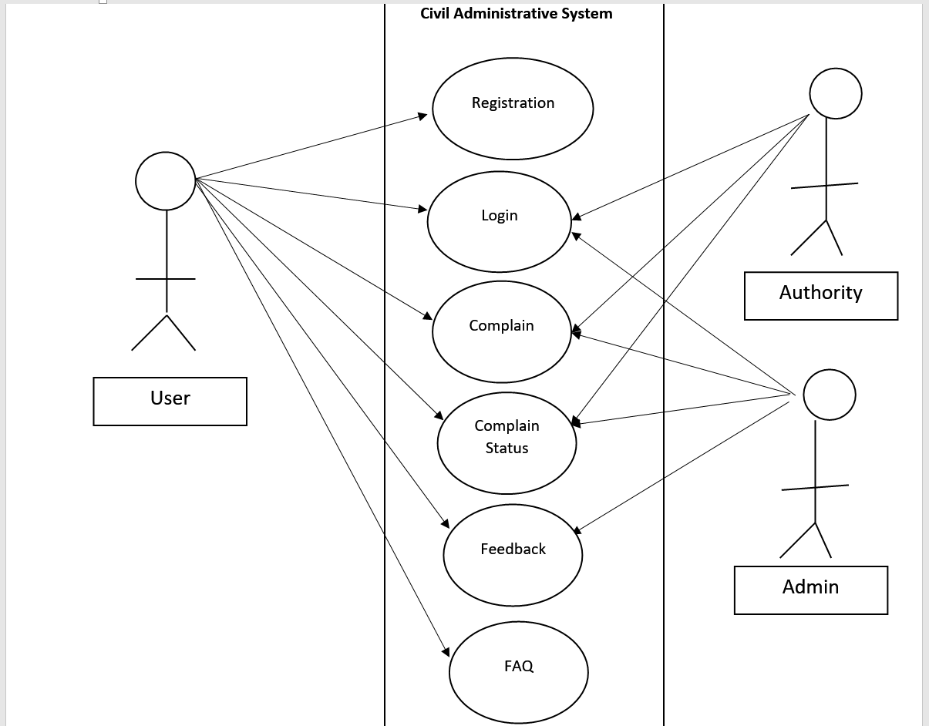
Usecase Diagram

Slide 13
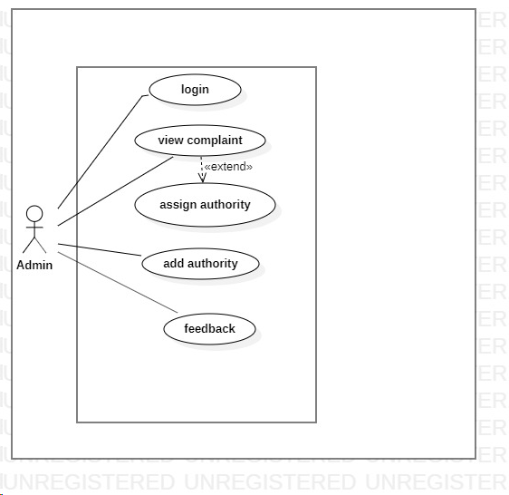
Admin Usecase Diagram

Slide 14
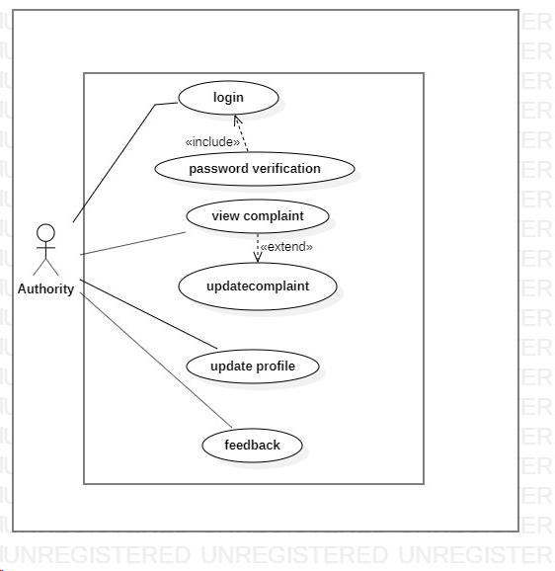
Authority Usecase Diagram

Slide 15
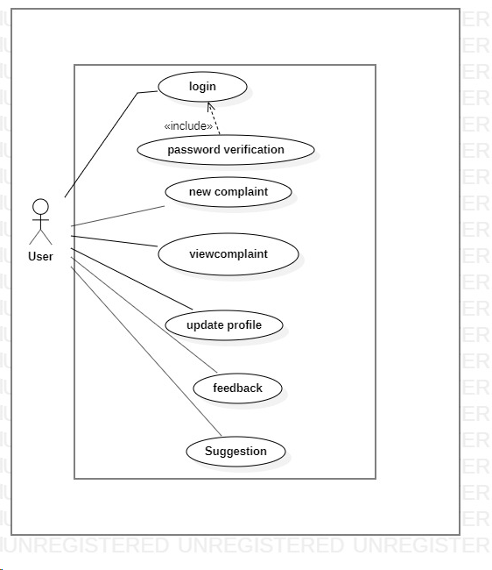
User Usecase Diagram

Slide 16
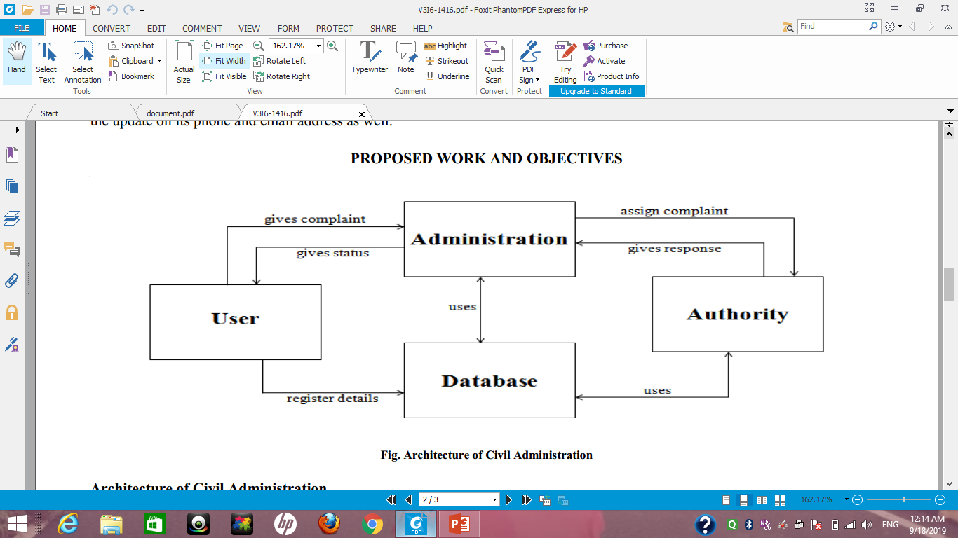
Architecture

Slide 17
Conclusion
Through our system first provided the communication between government officials and the citizens and their services.
Citizens can know place profile and information about problems they are facing in their area.
User can know complete information about the government related Activities.

Slide 18


